Slide 1


Slide 2
Delivery 3 Agenda
Project updates
Exploratory Data Analysis
Modelling
Things to do in Next Phase

Slide 3
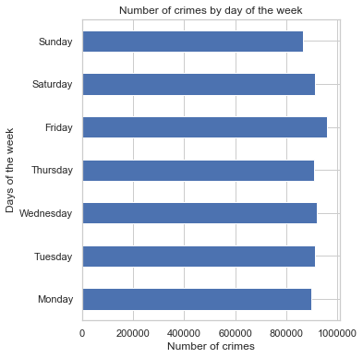
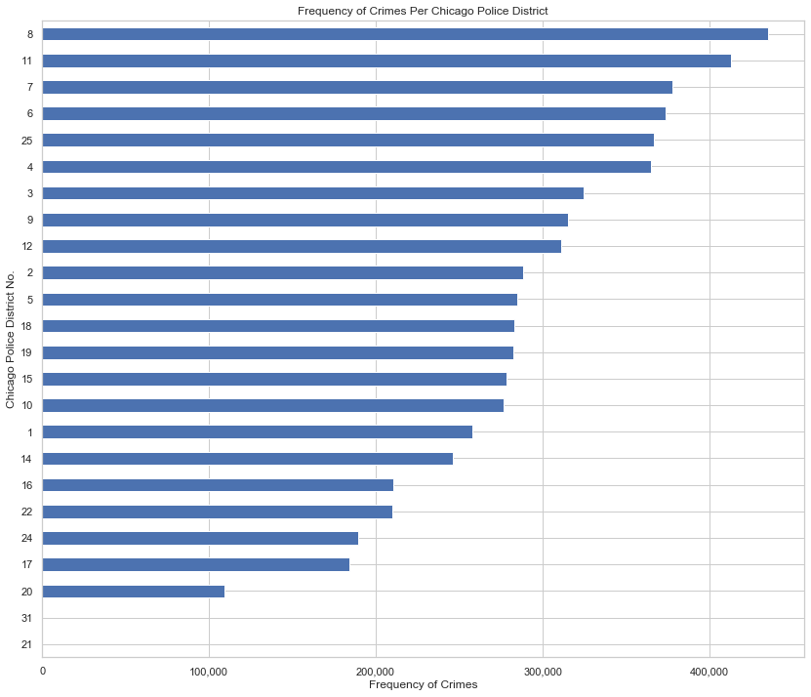
Exploratory Data Analysis

Slide 4
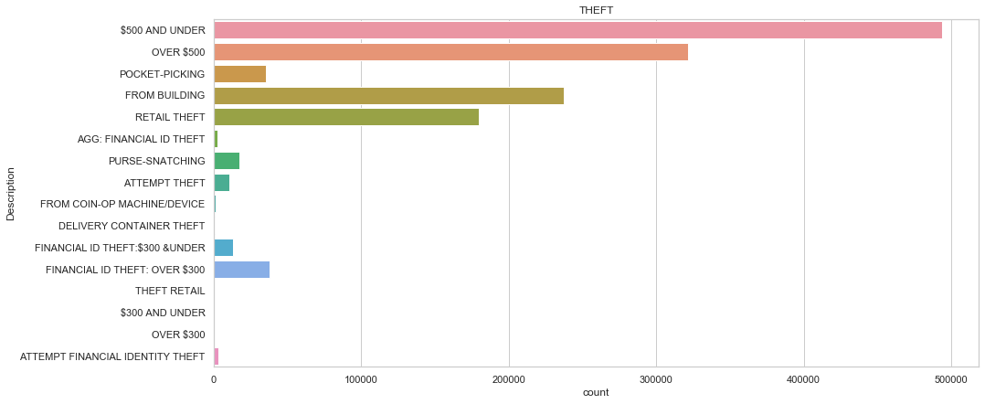
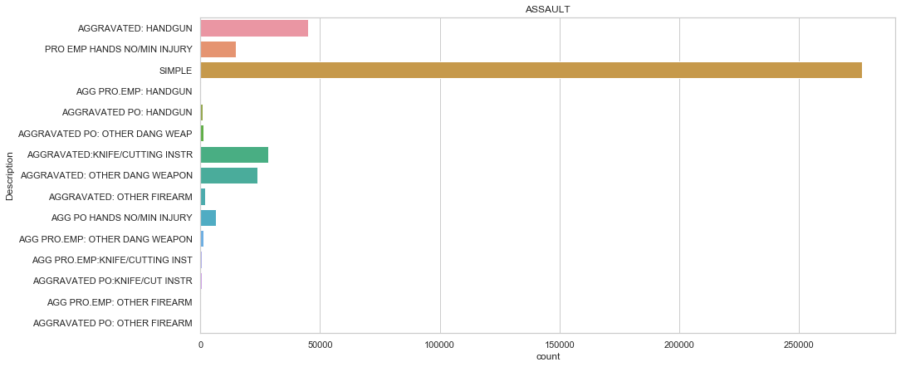
EDA

Slide 5
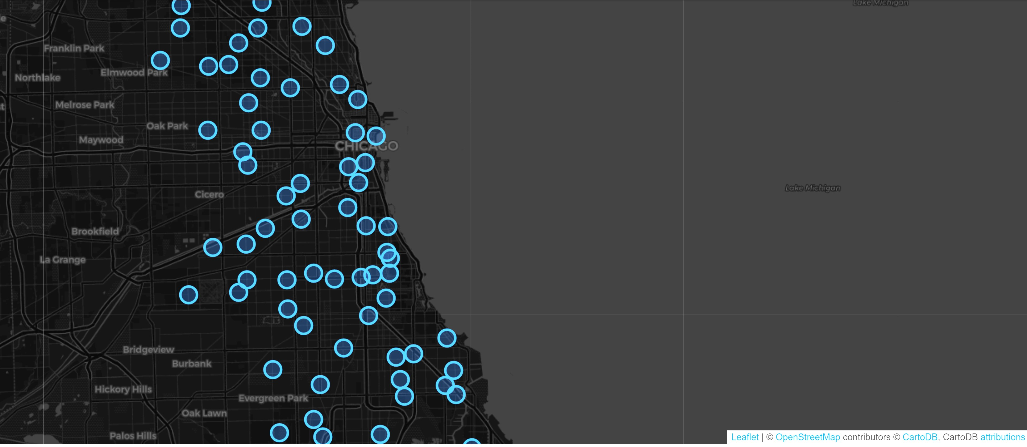

Slide 6
Data Modelling Workflow
Cleaning
Data cleaning
Preparing
Preparing the data
Choosing
Choosing the Target Variable
Splitting
Splitting the data
Wrangling
Data wrangling
Testing
Testing different models
Attaining
Attaining the best model

Slide 7
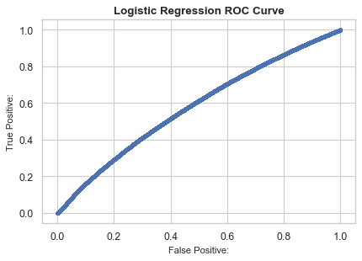
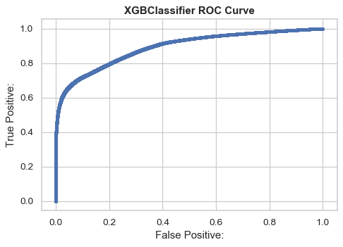
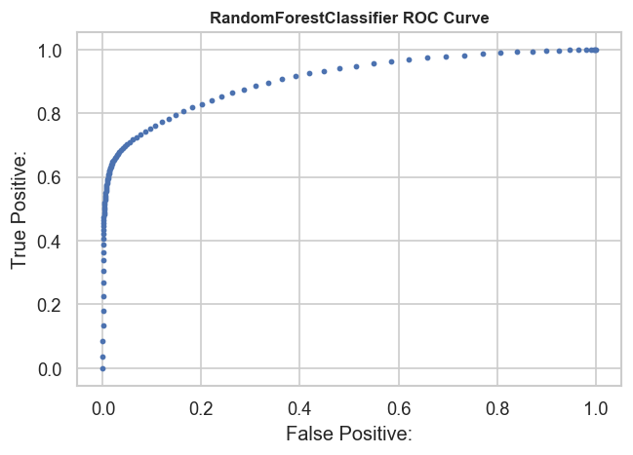
RandomForestClassifier shows best results

Slide 8
Things to do in Next Phase
Implementing multiclass multilabel classification for predicting the Primary Type of the Crime.
Experimenting with different algorithms.
Evaluate the performance of all algorithms used to decide which model is best for this case

Slide 9
THANK YOU☺

